Slide 1

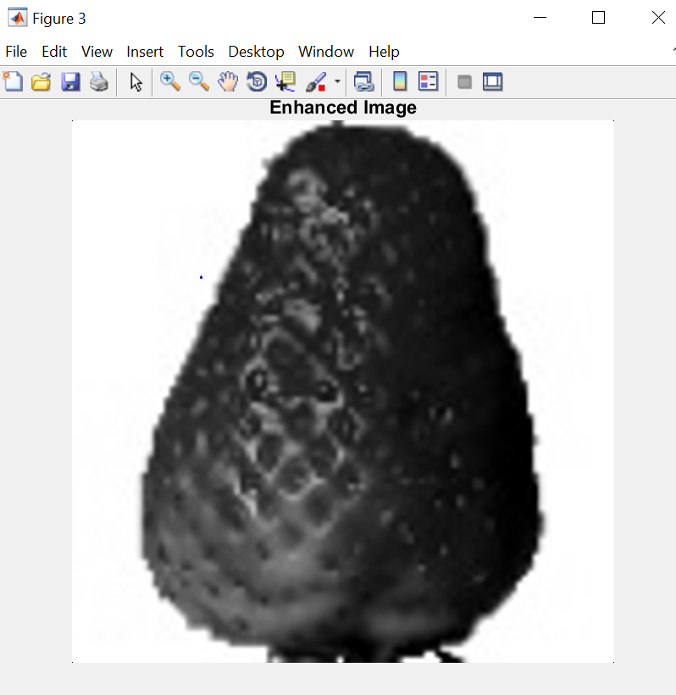
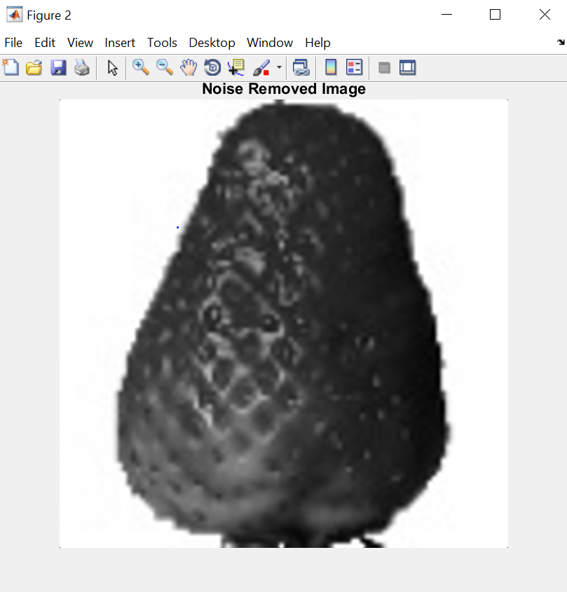
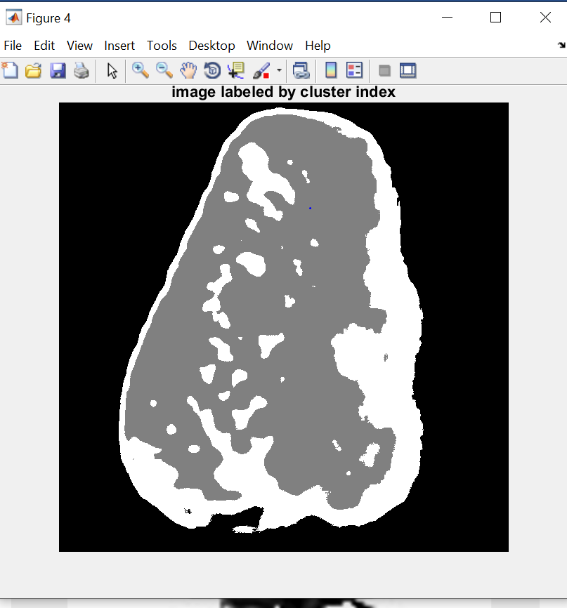
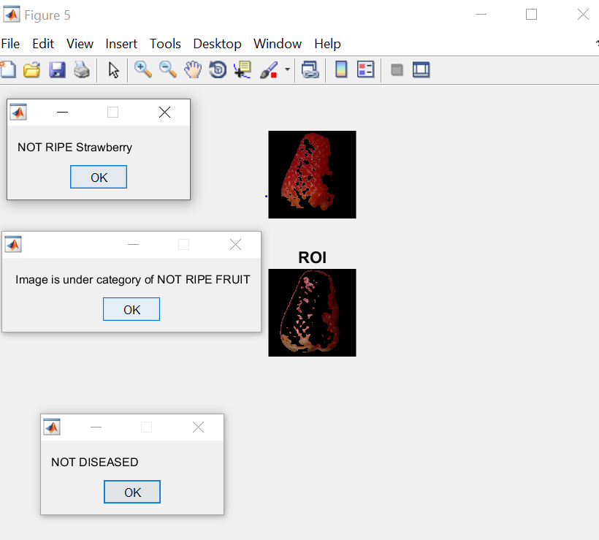
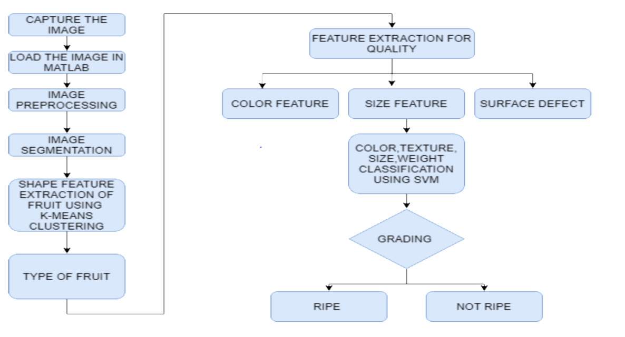
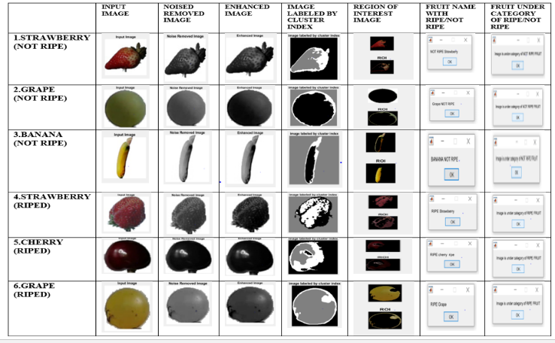
Fruit Maturity Detection using Matlab Image Processing
B Devi prasanna, Bokka sampreethi| Prof. Ravikumar C V | SENSE
Motivation/ Introduction
Results
Fruits play an important role in keeping the body healthy and have a few advantages. Fragrance and taste of the fruits are determined by its development level. Due to lack of storage facilities in developing nations like India, large amount of fruits are wasted. Therefore, there should be a method to determine the maturity level of harvested fruits. Manual picking of fruits and classifying them according to maturity and damage done may consumes more time. Taking these factors into consideration we proposed a technique to determine fruit maturity based on image processing using Matlab.
SCOPE of the Project
Figure 2
Figure 3
To achieve early detection of fruit maturity and diagnosis and treatment for the fruits is done by using image processing technique. Image processing technique using SVM gives better accuracy of results in less time. This technique uses GABOR wavelet feature extraction for better results. The main objective of this method is to ensure fruity quality and its nutritional values. This method also ensures that post harvest shelf life of fruits. It also facilitates scheduling and packing operations of fruits easy for farmers and also makes farmers marketing through internet or over the phone. This is best method for getting better results compared to other image processing techniques.
Methodology
Figure 4
Figure 5
Figure 2:The figure shows enhanced image after performing the preprocessing of the input image.
Figure 3:This figures shows the noise removed image after the removal of noise from the enhanced image using median filter.
Figure 4:This figure shows the clustered image after the segmentation is made to to the noised removed image using k-means clustering.
Figure 5:The clustered image is used for feature extraction using Gabor wavelet method. The Region of Interest (ROI)is extracted using clustered image. After the region of interest, the ROI classification is done using SVM. The final output of the fruit image is classified under the category of ripe or not ripe.
Figure 6:This figure shows the results obtained using SVM technique for dfferent kinds of riped and not not riped fruits.
FLOW CHART:1
In the proposed system we use support vector machine (SVM), for effective classification of fruits. The proposed algorithm uses:1) K-mean clustering 2) Gabor wavelet.3) support vector machine (SVM). In preprocessing stage, the image color index is reduced. The noise is removed using median filter. Then the images are processed using k-means clustering. the clustered image is used in the feature extraction. In the feature extraction we use speeded up robust feature algorithm-based scheme, called Gabor wavelet is used to get the better accuracy in less span of time. Gabor wavelet gives an accuracy of 97% in the output. Classification is done using SVM. The advantages of this prosed system are: Based on k-means clustering, segmentation and classification can be easily performed. Hence time consumption will be less.SVMs are much faster than multilayer perceptron networks and accurately predict target probability score
Figure 6
Conclusion/ Summary
This paper discusses an approach which is easily accessible and inexpensive of fruit maturity detection using SVM. SVM classification is much faster than multilayer perceptron network . Gabor wavelet method used for feature extraction gives an accuracy of 97% after the classification done using SVM. SVM classification results are better for K-means algorithm compared to different types of algorithms .This technique takes less time and gives better accuracy than existing methods .The results in this paper will help in automatic classification of various fruits in food industries for enhancing the fruit quality and maturity automatically.
Process of K-Means Algorithm:
1. The data set should be separated into K number of clusters and data points need to be allotted to each of these clusters randomly.
2. The distance from data point to each cluster is calculated using Euclidean distance which is nothing but the distance between two-pixel points and is given as follows: Euclidean Distance=√ ((x1-x2)² + (y1 -y2)²) where (x1, y1) & (x2, y2) are two pixel points
3. The data point which is nearer to the cluster to which it belongs to should be left as it is.
4. The data point which is not nearby to the cluster to which it belongs to should be then shifted to the nearby cluster.
5. Repeat all the above steps for entire data points. 6. Once the clusters are constant, clustering process needs to be stopped.
GABOR WAVELET:
Texture features are used on the various wavelet methods. Wavelet conversion is one of the most popular methods used for the time-frequency-transformations. The wavelets transform decomposes an input signal into low frequency and high frequency component using a filter. Wavelets can be separated into different basis functions for image compression and recognition. Gabor wavelet used to different methods but improve the efficiency of low and quality of different images in Gabor.
Contact Details
deviprasanna905@gmail.com, sampreethi66@gmail.com
Acknowledgments/ References
1.P Gokul shoraya Raj, P Suriyamoorthi”Estimation of volume and aturity of sweet ilme fruit using Image processing algorithm” IEEE 2015.
2. Hiroshi Kinjo, Naoki oshiro and Sam Chau Duong,” Fruit maturity detection using neural network and odour sensr” IEEE 2015.
3. H. S. Choi, J. B. Cho, S. G. Kim, and H. S. Choi, “A real-time smart fruit quality grading system classifying by external appearance and internal flavor factors,” 2018 IEEE International Conference.

